Slide 1


Microlevel structural poverty estimates for southern and eastern Africa
Big Brain Dollar Sign

Slide 2
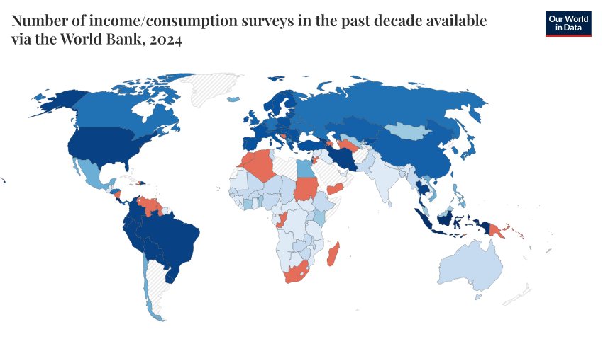
Notes:
How can you fight poverty if you can’t even see it?
In many countries in the Global South, particularly those impacted by colonisation, poverty data is often outdated, coarse, or missing entirely. Traditional household surveys are expensive, hard to administer, and usually only happen every 5 to 10 years.
That leaves major blind spots. We can’t improve what we can’t measure, and if we can’t see where poverty exists at a detailed level, we can’t target interventions properly.

Slide 3

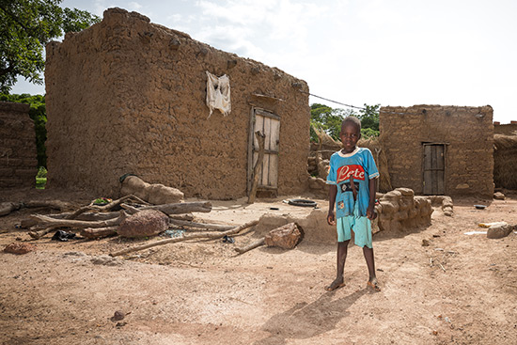
Notes:
This lack of data doesn’t just affect research, it has real-world consequences.
Policy makers and humanitarian organisations may focus aid where data exists, not necessarily where the need is greatest. That can result in communities in extreme poverty being missed altogether—despite being in most urgent need.

Slide 4
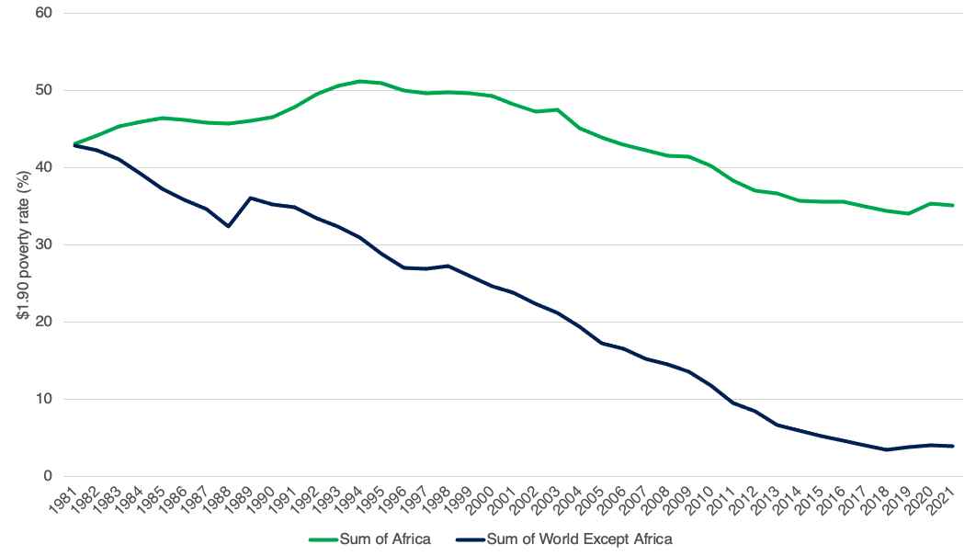

Notes:
One of the key global goals is to end extreme poverty, defined by the UN as living on less than $2.15 per day, by the year 2030. This is Target 1.1 of Sustainable Development Goal 1.
But if many low-income countries can’t even produce recent poverty estimates, it becomes impossible to track progress or hold governments accountable.

Slide 5
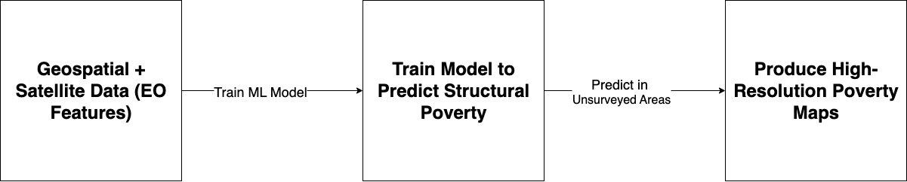
Notes:
This research tackles the problem using a two-step method.
It combines satellite Earth observation, accessible machine learning, and asset-based poverty metrics to estimate poverty at a micro level. The approach is tested across four countries in southern and eastern Africa, offering a new way to produce more timely and interpretable poverty maps, without needing constant surveys.

Slide 6
Key Terminology
Absolute vs. Relative Poverty
Structural vs. Realised Poverty
Asset-based vs. consumption-based (income- or expenditure-based measures) wealth indicators

Slide 7
Key Terminology
Small Area Estimates (SAE)
Earth Observation (EO)

Slide 8
Key Terminology
Foster-Greer-Thorbecke (FGT) Measures
Random Forest (RF) Regression

Slide 9
Methodology
Theory that consumption is closely related to income from assets
Uses nationally representative household surveys
  Contains data about productive assets
Develop RF-regression models
  Predict household consumption based upon the survey assets data
  Weighted by size of household
  Use surveyed areas to predict unsurveyed areas

Slide 10
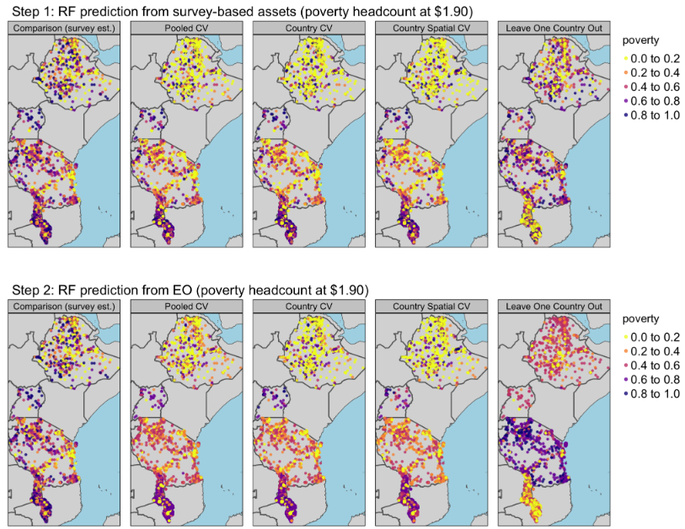

Slide 11
Methodology
Validation of results
K-fold cross-validation
  Train and test on clusters from the same country
Spatial k-fold cross-validation
  Train and test on spatially separated clusters
Leave-one-country-out cross-validation
  Train on three countries to predict the fourth

Slide 12
Key Findings
Machine learning + Earth Observation (EO) data predicts structural poverty better than realised poverty:
  $1.90/day line: 72% variance explained (40% out-of-country) vs. 57% (0%) for realised poverty.
  $3.20/day line: 78% variance explained (54% out-of-country) vs. 69% (26%).
Structural poverty comparable to asset wealth but policy-aligned.

Slide 13


Model Performance Insights
Strengths:
  High rank correlation (important for targeting).
  Effective in rural areas (R² ≈ 0.45–0.57).
Limitations:
  Underestimates poverty in the poorest clusters.
  Urban prediction weaker (R² ≈ -0.74 to 0.20).
  Bias grows for out-of-country predictions.

Slide 14
Implications
Structural poverty estimation enables better targeting of humanitarian and development interventions.
Provides interpretable, comparable measures across countries.
Requires in-country survey data for best accuracy.
Future research: enhance urban prediction, integrate deep learning, and address extreme poverty bias.

Slide 15

Questions

